Slide 1
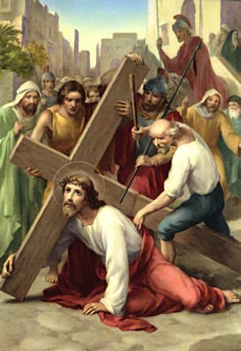
The Stations of the Cross
with a chastity focus
www.thegorettigroup.org
Stations photos taken from https://www.discerninghearts.com/catholic-podcasts/stations-of-the-cross-according-to-the-method-of-st-francis-of-assisi/
Experience the Joy of Pure Love

Slide 2
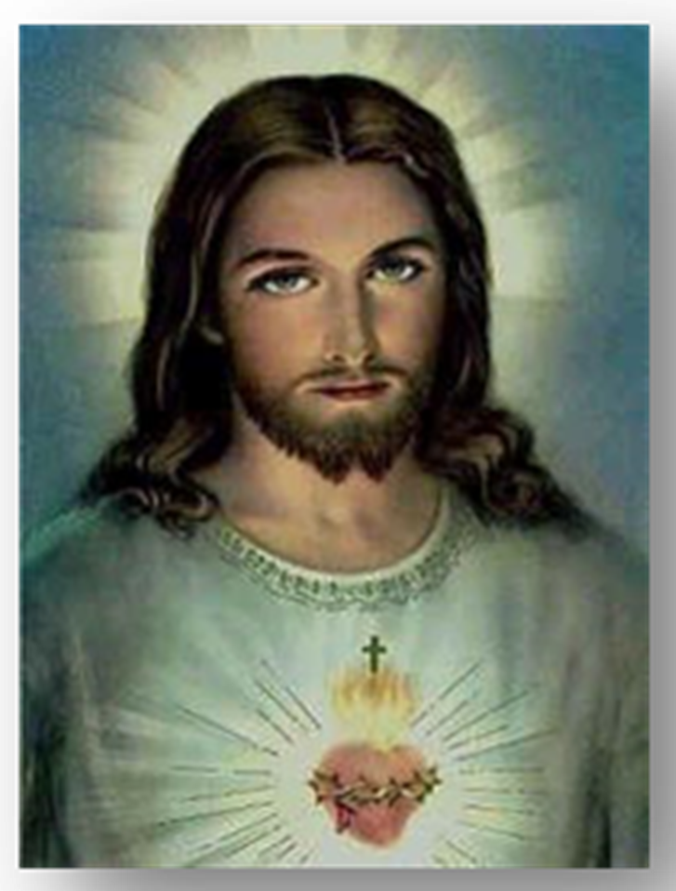
Opening Prayer
Leader: Jesus, You said, "Amen, amen, I say to you, everyone who commits sin is a slave of sin. A slave does not remain in a household forever, but a son always remains. So if the Son frees you, then you will truly be free.” (John 8: 34-36) In this fallen world, where each of us is broken by original sin and prone to stray from the purpose and plan for which You designed us, there seems to be no area of our humanity that shows the wounds of sin in our souls as profoundly as our sexuality. We need Your grace to be made entirely pure and chaste, so we can live in the freedom of Your love and plan for our life.
All: Lord, as we meditate on Your passion, and pray especially for chastity, may Your Spirit open our hearts to the truth that “God is love.” (1John 4:8) And, with that knowledge, may we learn to imitate the way of Your cross—laying down our lives for You as You laid down Your life for us.

Slide 3
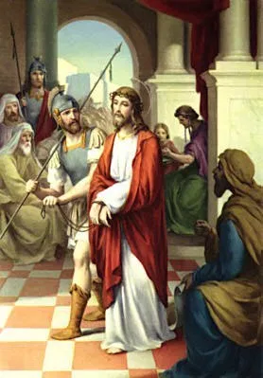
First Station: Jesus is condemned to death
Leader: We adore you O Christ, and we bless you,
All: because by your Holy Cross you have redeemed the world.
(Meditation) Reader: You offer life in abundance and come to make our joy complete. “Come, follow Me…” You invite. “Crucify Him!” We respond. Condemned by Your friends and followers, who just weeks before hailed You as King, You humbly accept to die as we demand, for You know that it is the fulfillment of Your Father’s will. You choose to pour out Your holy life in death on a cross in order that we might truly live.
Kneel
(Prayer ) All: Oh, Jesus, help us to receive the gift of pure love You offer us. You are the living water for which we thirst. Help us to surrender all to You, who offered Your life for us.
Hail Mary…
(Song) All: At the cross her station keeping, Stood the mournful Mother weeping, Close to Jesus to the last.

Slide 4
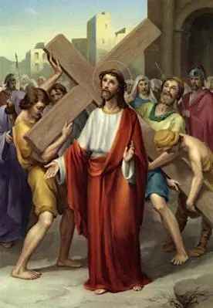
Second Station: Jesus carries His cross
Leader: We adore you O Christ, and we bless you,
All: because by your Holy Cross you have redeemed the world.
(Meditation) Reader: Already scourged beyond recognition, spit on and crowned with thorns, You take upon Your bloody back the weight of the wood to which You will be nailed. You look up at the rocky mountain before You, well aware of what lies at the top. You could stop this whole thing now….but You do not. You breathe in, close Your eyes and picture me. You see me in all my confusion and weakness, too deceived to even recognize my need to cry out for help. You look at me and You love me. As You breathe out, You step forward to come and set me free. Kneel
(Prayer) All: Oh Jesus, it is hard to stay pure in this world. Sexual messages bombard us everywhere. Help us to trust that Your love is better than the counterfeit loves that surround and entice us. Help us to fight the good fight for purity, relying on the True Love that carried the cross for us.
Hail Mary…
(Song) All: Through her heart, His sorrow sharing, All His bitter anguish bearing, Now at length the sword had passed.

Slide 5
Third Station: Jesus falls the first time
Leader: We adore you O Christ, and we bless you,
All: because by your Holy Cross you have redeemed the world.
(Meditation) Reader: You cling tighter to Your cross as You fall under its weight. Your body smashes into the dust and Your eyes open to see me lying next to You, sinful and broken, covered in disgrace. As Your eyes look into me, it is not my sin you see but the beautiful one You created in your image and likeness. “For we do not have a high priest who is unable to sympathize with our weaknesses, but one who has similarly been tested in every way, yet without sin.” (Heb 4:15) It is You who leads the way. You do not stay down deep in the dirt, but You stand up and march on in spite of the pain. “So let us (also stand up and) confidently approach the throne of grace to receive (Your) mercy…” (Heb 4:16)
Kneel
(Prayer) All: Oh Jesus, we are broken and weak. We are sinful, but Your mercy is great. Help us turn away from sin and let us unite our pain and brokenness to Your Cross as a holy offering. In this offering may we find purpose in our pain. Hail Mary…
(Song) All: Oh, how sad and sore distressed Was that Mother highly blessed Of the sole-begotten One!

Slide 6
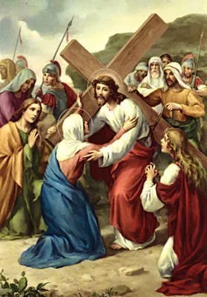
Fourth Station: Jesus meets His mother
Leader: We adore you O Christ, and we bless you,
All: because by your Holy Cross you have redeemed the world.
(Meditation) Reader: As Your beloved Mother looks into Your swollen eyes and can do nothing to relieve Your pain, she now understands the words that Simeon spoke to her when she held You as a baby: “And you, yourself a sword will pierce.” (Luke 2: 35) Her heart is pierced to see You pummeled under the weight of the world’s sins…under the weight of my sins. Yet she knows You must be about Your Father’s business and she does not try to stop You. She touches You gently on the hand that once grasped her thumb with love. As You continue on the way to Your execution, she prays in silence as You are crushed for my iniquities. Kneel
(Prayer) All: Oh Jesus, let Your most pure, Virgin Mother lead us to You. May we imitate her openness to life, her selfless “yes” to God, and her total trust, even in times of great trial. May we be as chaste and modest as Your dear Mother. Mary, Mother of Jesus, and our Mother, pray for us.
Hail Mary…
(Song) All: Christ above in torment hangs; She beneath beholds the pangs Of her dying glorious Son

Slide 7
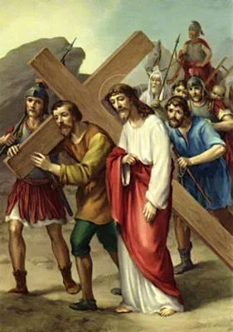
Fifth Station: Simon helps Jesus
Leader: We adore you O Christ, and we bless you,
All: because by your Holy Cross you have redeemed the world.
(Meditation) Reader: By now You are so severely wounded that the soldiers know if they do not offer You some relief, You will not make it to the top of the hill where the real torture can begin. So they enlist Simon. As he reluctantly stands beside You and feels the weight of Your cross on his back, he is shocked that someone so battered could be carrying so heavy a cross alone. Then the thought occurs—perhaps this is not just any man. As he looks into Your eyes, and sees his reflection, he realizes that it is not he who helps You carry Your cross, but You who help him carry his.
Kneel
(Prayer) All: Oh Jesus, let us help each other in this battle against “the rulers of this present darkness.” (Ephesians 6: 12) Help us to pray for one another and share with one another. The cross is much less heavy when two or more are carrying it, so give us courage to hold each other accountable and lead our brothers and sisters to Heaven.
Hail Mary…
(Song) All: Is there one who would not weep, ‘Whelmed in miseries so deep Christ's dear Mother to behold?

Slide 8
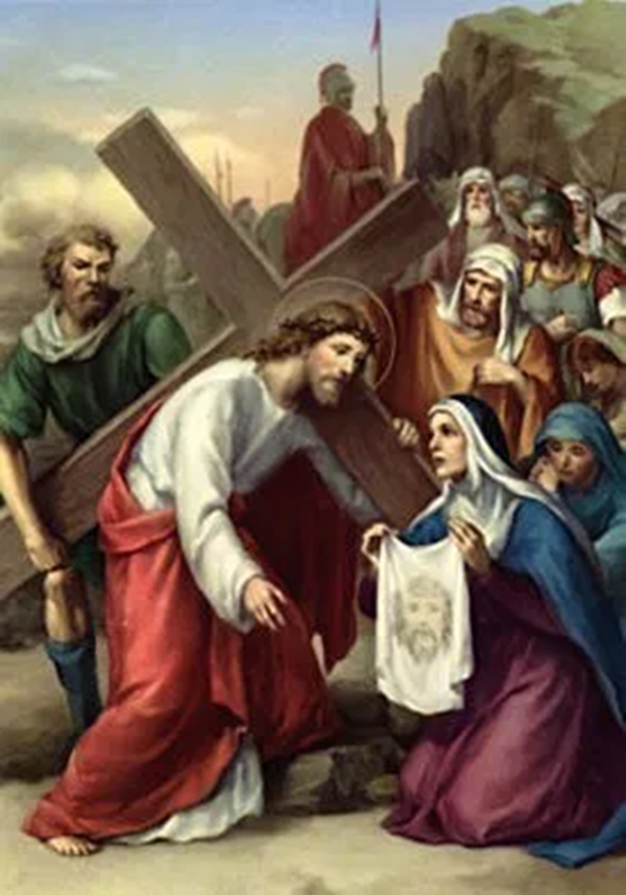
Sixth Station: Veronica wipes the face of Jesus
Leader: We adore you O Christ, and we bless you,
All: because by your Holy Cross you have redeemed the world.
(Meditation) Reader: Most of Your friends had run away in fear that Your gruesome fate might also be theirs. But Veronica is unafraid to show compassion to a condemned Man. She gently wipes the sweaty, muddy blood from Your face, relieving You, for a second, of the sting in Your eyes. So many people live with the sting of shame in their eyes, afraid to step out of the darkness of sin and brokenness for fear of rejection. Many suffer alone from the pain of having had an abortion. Others, who carry the cross of same-sex attraction are afraid to share their struggle. And many are weighed down by the burden of un-confessed sexual sins. Let me live with open ears and arms for those who are afraid to share the secrets they’ve been hiding for fear of condemnation. Help me to lead them to the One who died to forgive and renew them-- You, Lord, who makes all things new. Kneel
(Prayer) All: Lord, open our hearts to the ones that the enemy tries to keep in the dark. Bring them to us that we might show them the compassion Veronica showed You. Give us Your love for all Your children, that they may know there is no need to hide, only need to fall into Your immeasurable mercy and, there, be made whole. Hail Mary…
(Song) All: Is there one who would not weep, ‘Whelmed in miseries so deep, Christ's dear Mother to behold?

Slide 9
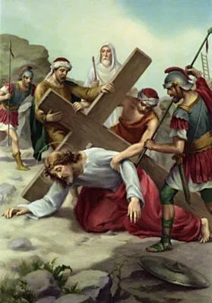
Seventh Station: Jesus falls a second time
Leader: We adore you O Christ, and we bless you,
All: because by your Holy Cross you have redeemed the world.
(Meditation) Reader: As Your legs fail again under the weight of the cross, and fresh Blood oozes from Your knees, I imagine You would like to stay there on the ground. But You don’t. You press Your hands into the rocks and push Yourself up, with eyes fixed on Your goal: my redemption. Though I fall again and again You do not give up on me. How persistent is Your loving pursuit of me, and at what high a cost! Help me not to give up on myself, but to forgive myself, just as You forgive and clear away all my sins as I leave them behind in the Confessional. Kneel
(Prayer) All: Oh Jesus, give us the grace to return to the Sacrament of Reconciliation with humble and contrite hearts, no matter how many times we may have to crawl back, after falling into the same sins. Hail Mary…
(Song) All: Bruised, derided, cursed, defiled, She beheld her tender child All with bloody scourges rent.

Slide 10
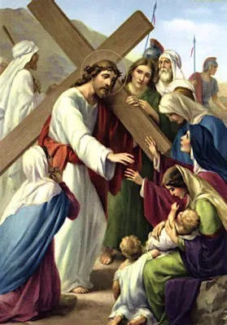
Eighth Station:
Jesus speaks to the women of Jerusalem
Leader: We adore you O Christ, and we bless you,
All: because by your Holy Cross you have redeemed the world.
(Meditation) Reader: Your dry throat musters what voice it can to console the women who weep for you. “Daughters of Jerusalem, do not weep for me; weep instead for yourselves and your children.” (Luke 23:28) You call them daughters and say weep for yourselves--women who are saintly and women who are steeped in sin; women who are taken advantage of and sold into slavery; women who struggle with body-image, unaware of their inherent beauty …and all the women who will never be born, because they were not given the chance to live outside the womb--these especially are the daughters for whom You weep. Kneel
(Prayer) All: Oh Jesus, our world is so broken. We do not understand the dignity of a human being. Please cast out the lies we have believed about our value and the value of others, and let us see each person as You see us:--Your beloved ones, bought at the price of Your Blood. Hail Mary…
(Song) All: For the sins of His own nation, Saw Him hang in desolation, Till His spirit forth He sent.

Slide 11
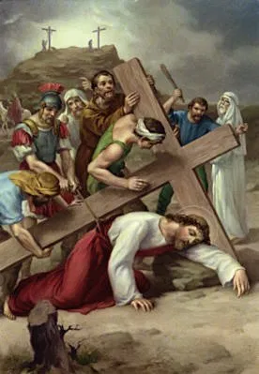
Ninth Station: Jesus falls a third time
Leader: We adore you O Christ, and we bless you,
All: because by your Holy Cross you have redeemed the world.
(Meditation) Reader: You’ve fallen again. You know first hand, how much harder it is to get up from the ground when your head is in the mud. How many suffer from repeated falls--sins that seem impossible to overcome? How many in our world are addicted to pornography and other sexual sin? As the wood of Your cross strikes Your head, and the thorns press deeper into Your skull, You feel the pain of those who suffer from addiction, and love for them gives You the strength to go on. You stand again, determined to save them from the cycle of destruction. And, indeed, Your Precious Blood, willingly spilled on the hill of Calvary, contains within it the power to lead everyone to freedom, peace, and purity. Kneel
(Prayer) All: Oh Jesus, help those who struggle with addiction to cry out to You and admit their helplessness. May the same strength that allowed You to carry Your cross on the way to the Resurrection, be theirs, as well. Hail Mary…
(Song) All: O sweet Mother! fount of love! Touch my spirit from above; Make my heart with yours accord.

Slide 12
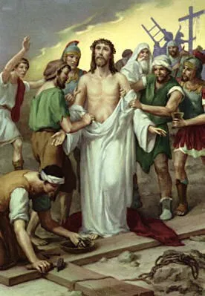
Tenth Station: Jesus is stripped of His garments
Leader: We adore you O Christ, and we bless you,
All: because by your Holy Cross you have redeemed the world.
(Meditation) Reader: Naked. The King of Kings is stripped bare before His Mother, before His friends, before the world. As they peel the cloak from Your raw skin, You stand silent, humbly offering Your Broken Body to all who will receive. How vulnerable and loving a God we have -- You, who hung naked from a cross so I could be clothed in righteousness. May I be as vulnerable to You as You are to me. Kneel
(Prayer) All: Oh Jesus, help us to lay our lives before You, stripped of all facades. Let us take off any false labels we have clothed ourselves in, and be robed in new garments of grace, washed in Your Blood, there finding our true identity as daughters and sons of God. Hail Mary…
(Song) All: Make me feel as you have felt; Make my soul to glow and melt With the love of Christ our Lord.

Slide 13
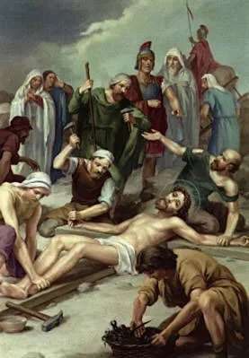
Eleventh Station: Jesus is nailed to the cross
Leader: We adore you O Christ, and we bless you,
All: because by your Holy Cross you have redeemed the world.
(Meditation) Reader: Agony floods Your entire body as a nail is pounded into Your left wrist. You are jolted again, as they lay Your right hand down for the second blow. Writhing with your arms stretched and hooked to the cross, You watch now as the sharpest, longest nail hovers above Your ankles and the soldier flails his arm behind him. With the rush of his mallet, the metal bursts through Your feet, locking them to the wood. Everything blurs. Love is crucified. All this You endured to restore humanity’s relationship with Our Father. And this Sacrifice, which You offered once and for all some 2,000 years ago, transcends time and is re-presented to us every day through the miracle of Eucharist. You did not leave us orphans, but gave us priests to make Your very Body, Blood, Soul and Divinity available to us daily, that, through the Blessed Sacrament, we might be saved and sanctified.
(Prayer) All: O Jesus, thank You for the incomprehensible gift of the Eucharist. Thank You for devoted priests who lay down their lives to make Your Presence available to us through the Sacraments. Strengthen our priests and let those You are calling to the priesthood have the courage and grace to respond generously to Your invitation…Hail Mary…
(Song) All: Holy Mother! pierce me through; In my heart each wound renew Of my Savior crucified.

Slide 14
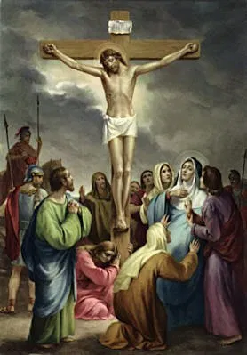
Twelfth Station: Jesus dies on the cross
Leader: We adore you O Christ, and we bless you,
All: because by your Holy Cross you have redeemed the world.
(Meditation) Reader: “Jesus cried out in a loud voice, ‘Father into Your hands I commend my spirit,’ and when He had said this, He breathed His last.” (Luke 23:46) The eyes that looked with love on a woman caught in adultery are emptied of life. The voice that spoke a new identity into fishermen and tax collectors is silenced. And the heart that once grew in the womb of Mary ceases to beat. “It is finished.” Christ the Bridegroom has died for His Bride, the Church. And, certainly, there is no greater love than this. Kneel
(Prayer) All: : Lord, bless Your Bride, the Church with more Christ-centered marriages. Bless husbands and wives that they may die to self and give their love freely to one another. Bring an end to contraception, and let the truth of Your plan for man and woman be embraced as never before. Restore broken marriages, and prepare engaged couples to enter the holy Sacrament of Marriage. Hail Mary…
(Song) All: Let me share with you His pain, Who for all my sins was slain, Who for me in torments died.

Slide 15
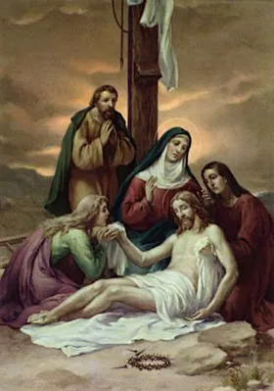
Thirteenth Station: Jesus’ Body is taken off the cross
Leader: We adore you O Christ, and we bless you,
All: because by your Holy Cross you have redeemed the world.
(Meditation) Reader Your Body, marred beyond recognition, yet still, the unblemished temple of the Holy Spirit, is taken off the cross and laid in Your mother’s lap. As she looks upon her lifeless Son, all hope seems lost. Tragically, many victims of sexual abuse are left to feel like their life has been taken from them. Hope seems a far cry. But just as You healed the woman who but touched Your cloak, Your Broken Body offers healing to those who have endured even the deepest wounds of the heart. Kneel
(Prayer) All: Oh Jesus, heal the hearts of those who have been sexually abused. May they know their true dignity and worth in You. Protect them from the lies of the enemy and restore them to joy, peace and hope. May Your healing love be offered to many through our prayers and actions. Hail Mary…
(Song) All: Let me mingle tears with you, Mourning Him who mourned for me, All the days that I may live

Slide 16
Fourteenth Station: Jesus is laid in the tomb
Leader: We adore you O Christ, and we bless you,
All: because by your Holy Cross you have redeemed the world.
(Meditation) Reader No life left in You; You are bound, not in swaddling cloth, but in burial cloth. But the burial perfume of Myrrh was with you even in the manger— “For the Son of Man did not come to be served but to serve and to give his life as a ransom for many.” (Mark 10: 45) You told Your disciples not to fear, for this cave is not Your final resting place. On the third day You will rise again. You have gone to prepare a place for us in Your Father’s house—where every tear will be wiped away, and the darkness of sin will be no more. And so the Song of all Songs rings true: “For strong as death is love, unyielding as the grave.” (Song of Songs 8:6) Kneel
(Prayer) All: Oh Jesus, You are the Way and the Truth and the Life. You took on the penalty for our sin. With Your last breath, You breathed new life into us—Your very Spirit. Help us to live in the understanding of Your deep and personal love for us and under the reign of Your Holy Spirit. May we daily take up our crosses and follow You, knowing that without the Cross, there can be no Resurrection. Hail Mary…
(Song) All: By the cross with you to stay, There with you to weep and pray, Is all I ask of you to give.

Slide 17
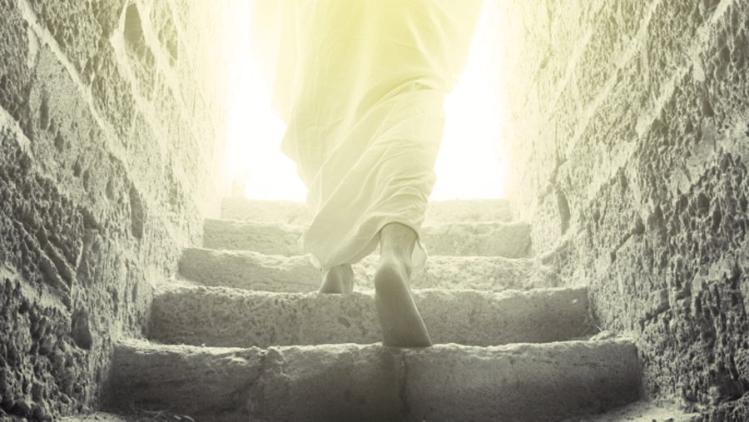
Closing Prayer
Leader: “…If the Son frees you, you will truly be free.” (John 8:36) Indeed, Jesus, You, the Living Son of God, endured all this to set us free. We thank You for the gift of abundant life that pours out onto us through Your wounds, that we might be healed. We thank You for giving us Your Spirit, through Whom we can cry, “Abba Father!” (Romans 8:15) as beloved children of our Heavenly Father who gives good things to all who ask. And so, together, we ask…
Photo taken from https://stream.org/witness-to-the-resurrection/
All: Holy Spirit, set us on fire with the love of Christ that we might follow His command to love one another as He has loved us. Give us the grace to die to sin, to the world and to ourselves, that we might live only for Jesus. Stir to flame the gifts of God within us, especially the “spirit of power and love and self- control” (2 Tim 1: 6). Let us “not conform to this age, but be transformed by the renewal of our minds” (Romans 12: 2), as You make us pure in our thoughts, words and actions. Let the light of Your pure love shine through us and lead all souls to the Sacred Heart of Jesus. Amen.
Sacred Heart of Jesus… Have mercy on us.
Immaculate Heart of Mary… Pray for us.
Saint Maria Goretti… Pray for us
All you angels and saints… Pray for us

